Slide 1

Online Quiz System Final Project
Marcos Hernandez & Sencere Rabel

Slide 2
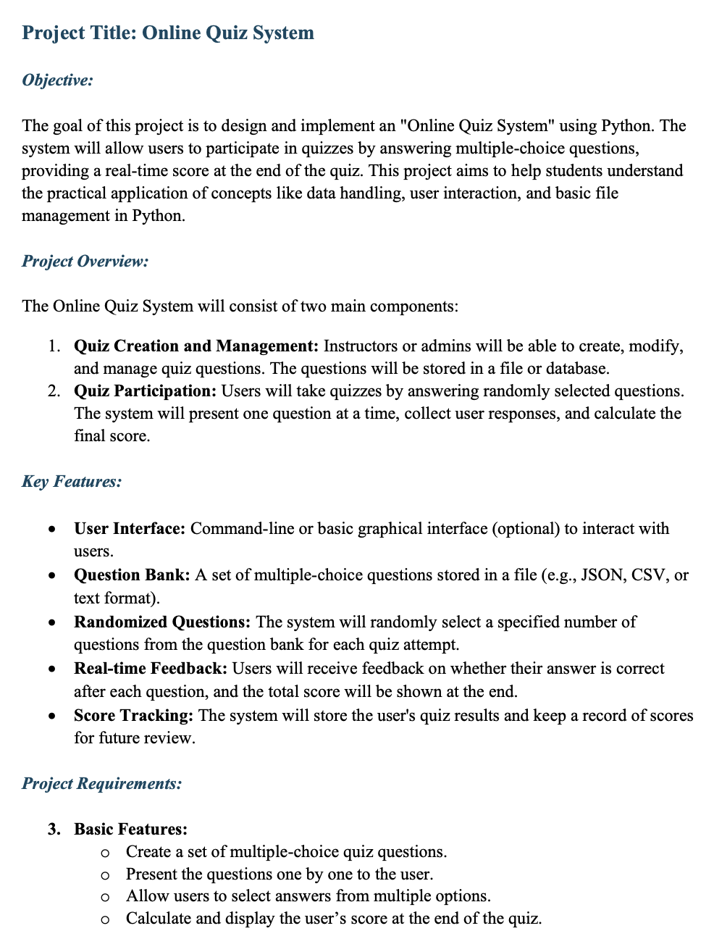

Slide 3
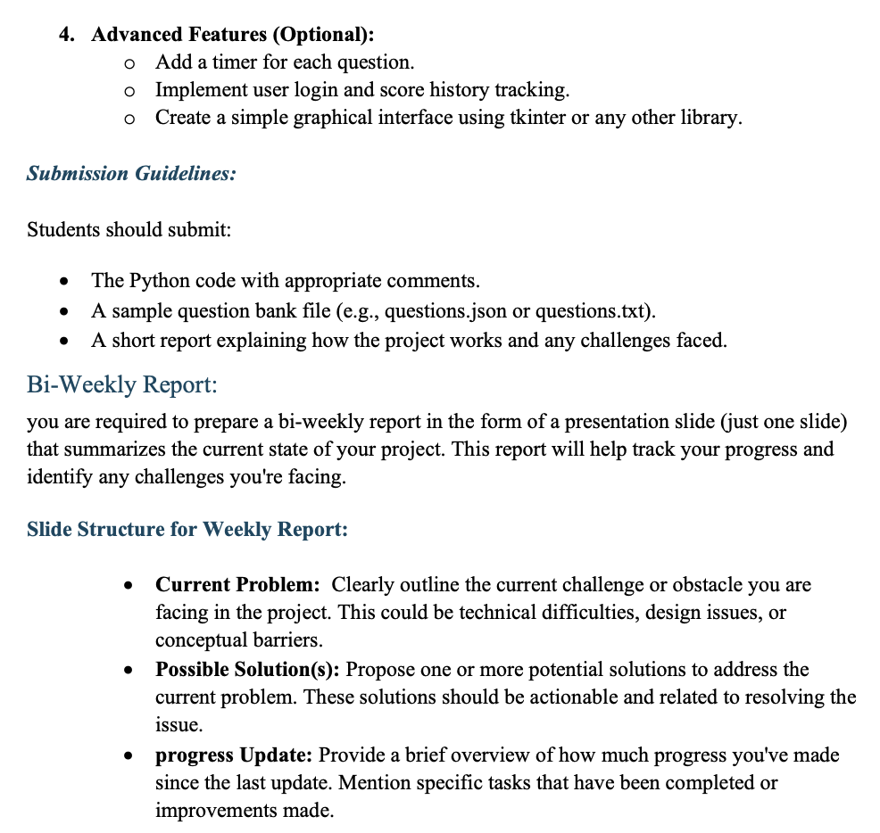

Slide 4

Meeting One:
Oct 3rd
Current Problem: Creating a question bank
Possible Solution(s): have questions taken from a csv and them in a list that’s value can be accessed at random
Actually, store them as a dictionary with the questions as the key and the value as the answer.

Slide 5

Key features for the project
October 8th
^{Problem: Key Features}
^{Solution:}
^{User interface- simple I/O}
Question Bank- .csv -> read, add to a dictionary
Randomized questions- Dictionary
Real-time feedback- if else statement
^{Score tracking- simple counter}

Slide 6

Project modules, MVP
Oct 15th
Created the repository
Modules Structure Breakdown:
Question- Question Bank, and the randomization
User- feedback, User interface, score tracking
Create mvp- create a draft version with basic components

Slide 7

Question Display
Problem: Displaying and shuffling answers in list
Solution: store value and then…shuffle list
Progress: created methods to store and retrieve questions from bank

Slide 8
ERD- UML

Slide 9
Login
Nov 12th
Current Problem: Making a login system
Possible Solution(s): Having the student class store the userID and Password then a function that verifies the user and password before signing the user in
Progress? Started working on the modules and created classes for Instructor, Student and System

